Slide 1
Application of reinforcement learning for automated content validation towards self-improving online courseware
Noboru Matsuda & Machi Shimmei
Center for Educational Informatics
Department of Computer Science
North Carolina State University

Slide 2
Online Course
Aka MOOC: Massive Open Online Course
Potential for a significant impact on outreach and learning
Tremendous volume of students
A wide variety of courses

Slide 3
Problem
Creating effective large-scale online course is very hard
Existing design theories still require iterative engineering
Lack of scalable method for evidence-based feedback

Slide 4
Need
Scalable and efficient learning engineering methods
Evidence-based iterative online courseware development

Slide 5
Solution
PASTEL: Pragmatic methods to develop Adaptive and Scalable Technologies for next generation E-Learning

Slide 6
Rafine
Reinforcement learning Application For INcremental courseware Engineering
Compute a predicted effectiveness of individual instructional components on online courseware

Slide 7
Relevance to GIFT
Evidence-based courseware improvement
The system can automatically flag contentious instructional components

Slide 8
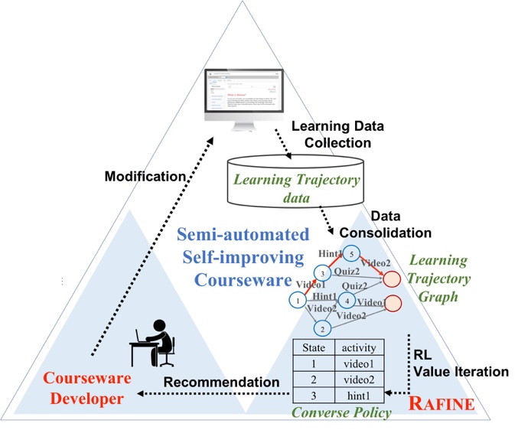
Self-Improving Online Courseware

Slide 9
Reinforcement Learning
Given a state transition graph with goals and a reward for each state,
a policy shows optimal actions that should be taken for a particular state
to maximize a likelihood of reaching to desired goals

Slide 10
Learning Transition Graph
Video2
A+
Quiz1
Quiz2
Video1
Passage1
B-
Quiz1
Video1
Passage1
Video1
C
Video1
F

Slide 11
Rafine: Hypothesis
If students learning activities were represented as a state transition
A state represents students’ intermediate learning status, and
An edge represents an instructional component
Then by defining reward for each state, we can compute a “policy” that represents the least optimal instructional component for each state

Slide 12
Rafine: Hypothesis (cont.)
Converse policy
The least optimal policy
Instructional components the most frequently appear as converse policy is likely to be inefficient

Slide 13
Rafine: State Representation
<ah, p(𝜇)>
ah : Action History <ah₁, …, ah_{n}>
ah_{i} = 1 if the i-th instructional component has been taken
p(𝜇) : Mastery Level
BKT on a given skill model

Slide 14
Value Iteration
Utility is a function of a state
Where a student came from to the current state matters
Reached a state when …
Mastery Level increased vs. decreased
$$V^{π}\left(s\right)=\sum_{s′∈S}{\left.T(s,π\left(s\right),s′){\left(R(s,π\left(s\right),s^{′})+γV\right.}^{π}(s′)\right)}$$

Slide 15
Reward
Based on the growth of Mastery Level
$$R\left(s,a,s′\right)=\left\{\begin{matrix}−0.14 \left(p^{s}\left(μ\right)=p^{s′}\left(μ\right)\right) \\ −0.05 \left(p^{s}\left(μ\right)<p^{s′}\left(μ\right)\right) \\ 0.95 \left(0.85≤p^{s′}\left(μ\right)\right)\end{matrix}\right.$$

Slide 16
Converse Policy
The action that minimizes the value function
$$π\left(s\right)=\underset{a∈A\left(s\right)}{argmin}{\sum_{s^{′}∈S}{\left.T(s,a,s′)(R\left(s,a,s^{′}\right)+γV^{π}\left(s^{′}\right)\right)}}$$

Slide 17
Converse Policy (Cont.)
G: learning trajectory graph, |G| = N
There are N instructional components in a converse policy
$π\left(s\right)$ : instructional component not to be taken at state s
Usually # instructional components << N
All instructional components appear in the converse policy

Slide 18
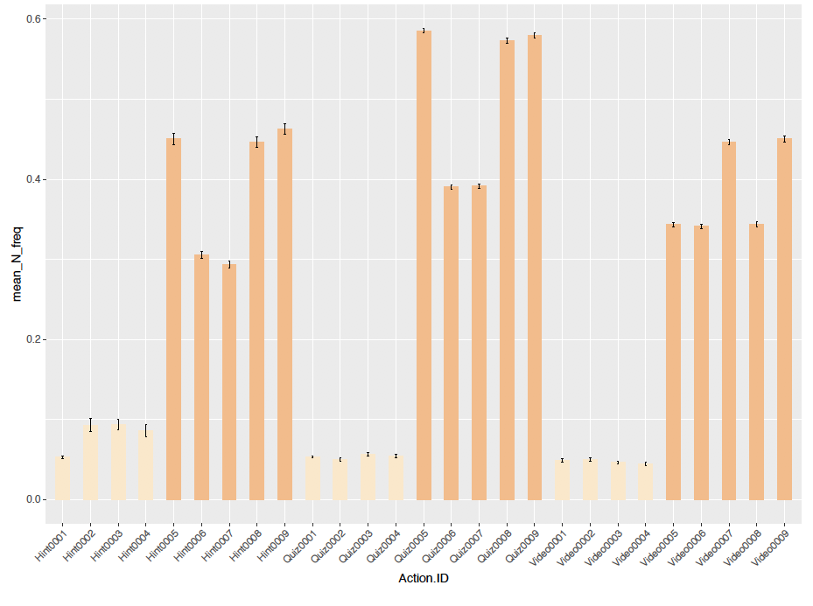
Frequency Heuristic
Only take those instructional components that frequently appear as a converse policy in a given learning trajectory graph

Slide 19
Simulation Study: Method
Generated hypothetical students’ leaning performance data on mock online course
Mock online courseware
3 pages with 3 videos and 3 quizzes per page (9 instructional components each type)
Quality controlled
High (8:1), Mid (4:5), Low (1:8)

Slide 20
Simulation Study: Data
100 instances of mock courseware created for each quality
High, Mid, Low : total 300 instances of courseware
1000 students worth of learning trajectory were randomly generated for each instance of courseware
300 x 1000 = 300,000 learning trajectories
Converse policy was computed over the 1000 trajectories for each courseware
100 converse policies for each H, M, L courseware

Slide 21
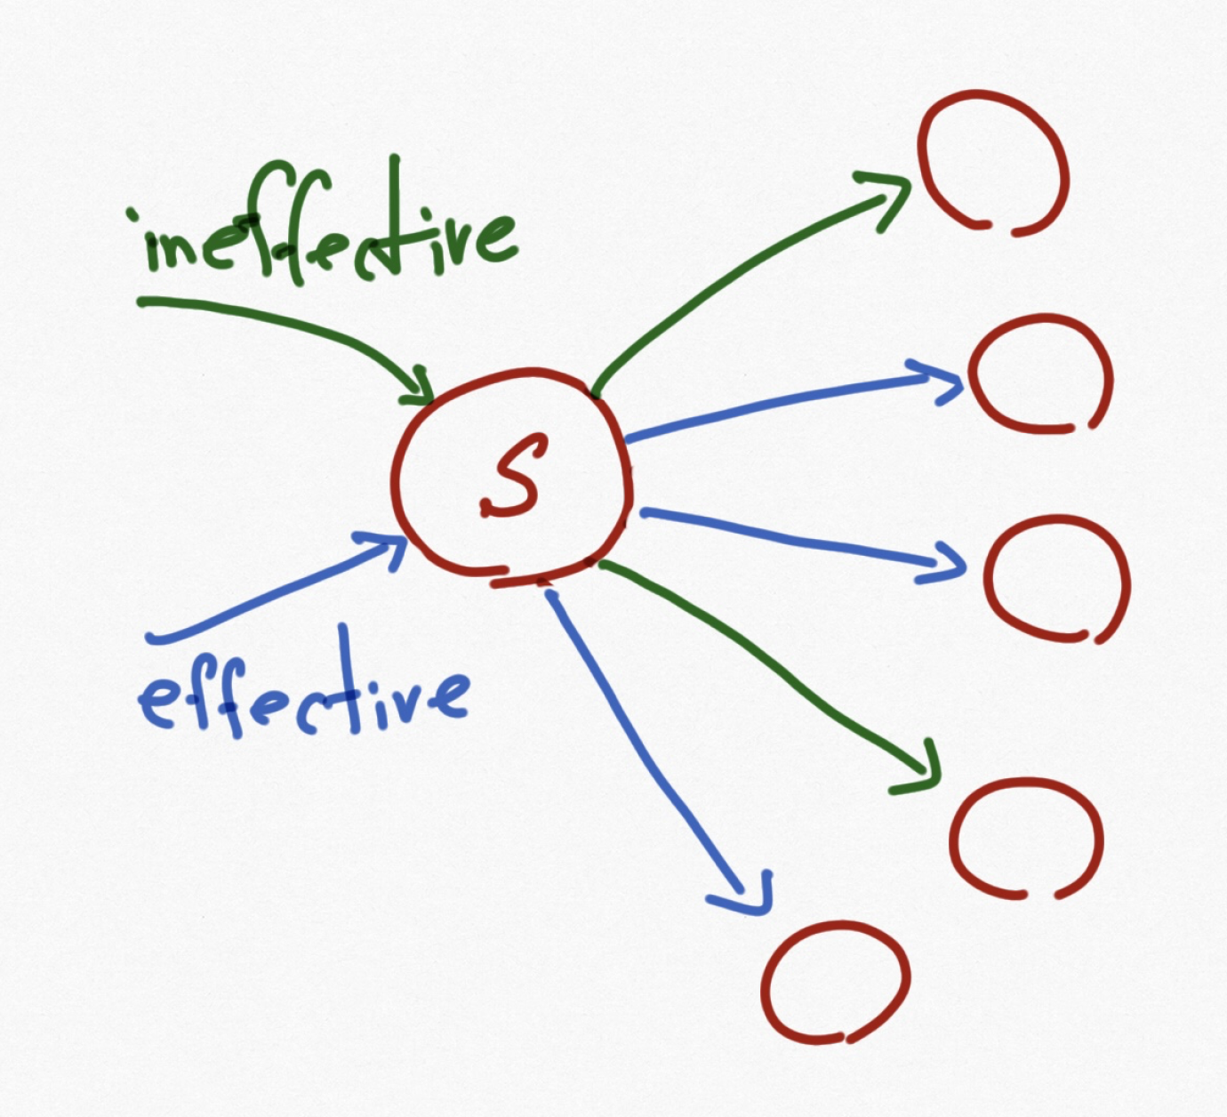
Results: Overall Accuracy of Converse Policy
How does a Converse Policy select ineffective instructional component better than a chance?
2/5 ineffective
IE Ratio

Slide 22
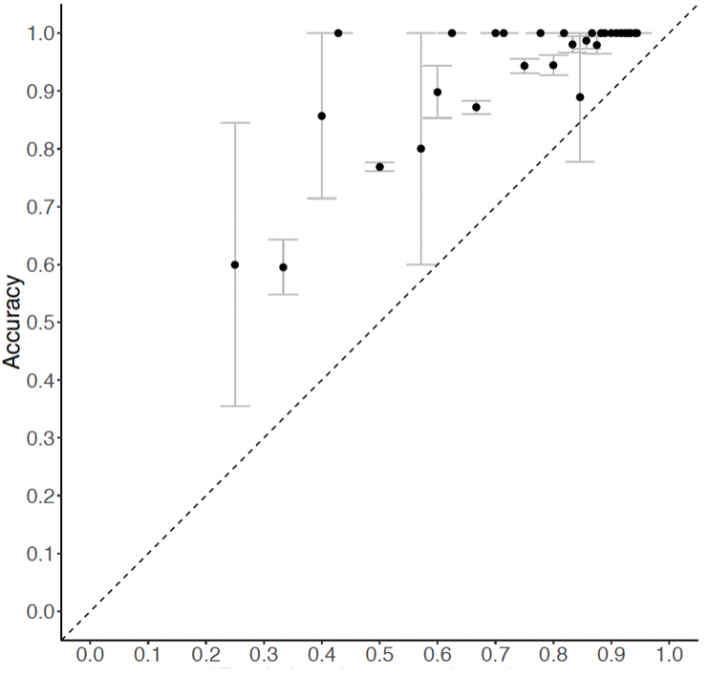
Results: Overall Accuracy of Converse Policy
Accuracy
Low quality courseware
IE Ratio

Slide 23
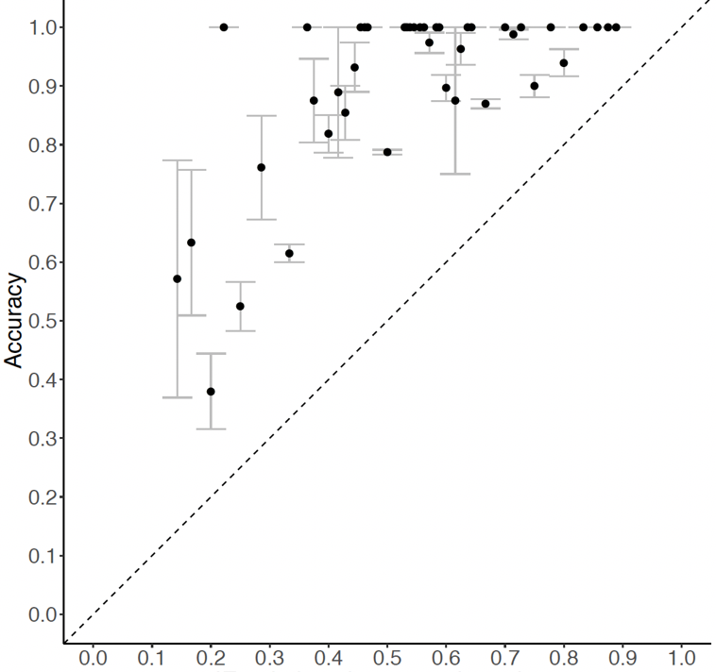
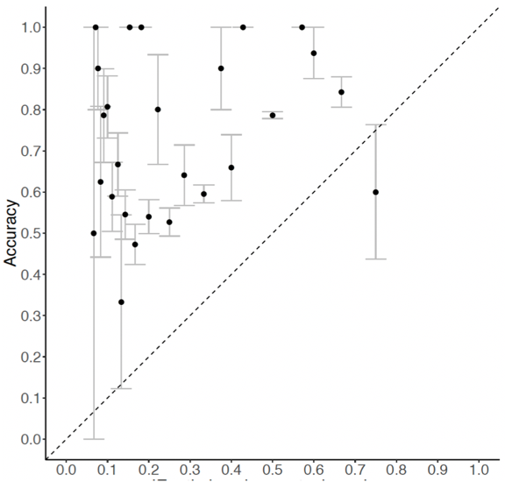
Results: Overall Accuracy of Converse Policy
Low
Mid
High

Slide 24
Results: Frequency Heuristic
After applying the frequency heuristic, how well does Rafine identify ineffective instructional components?
How ”frequent” is frequent?
M ± SD

Slide 25
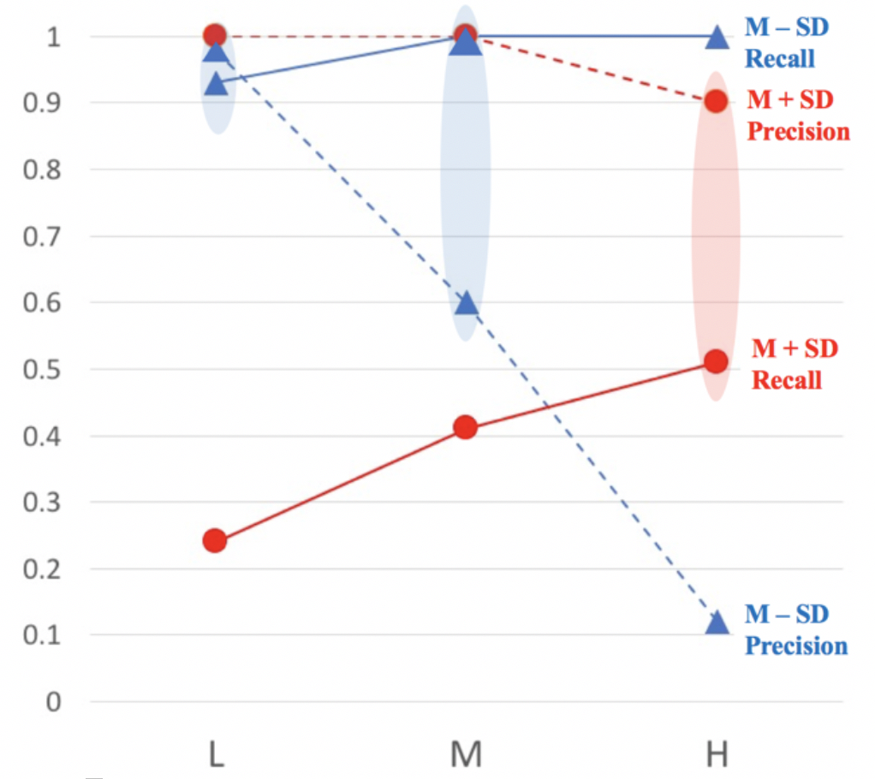
Results: Frequency Heuristic

Slide 26
Results: Frequency Heuristic
Use M-SD for premature courseware, switch to M+SD over time.

Slide 27
Conclusions
When students’ learning trajectories are consolidated into a state transition graph,
the converse policy that represent the least optimal action (instructional component to be taken) can be computed
with a high accuracy of identifying ineffective instructional components.

Slide 28
Conclusions (Cont.)
The Frequency Heuristic yields highly trustworthy recommendations for courseware improvement.

Slide 29
Future Work
Evaluate the practical effect of the Rafine method
Apply Rafine to real data…
The courseware must be structured with skills, AND
A closing-the-loop evaluation

Slide 30
Recommendations to GIFT
Provide API to tag instructional components with skills
Provide API for authoring tool to flag ineffective components
Provide students freedom on choosing learning activities

