Slide 1

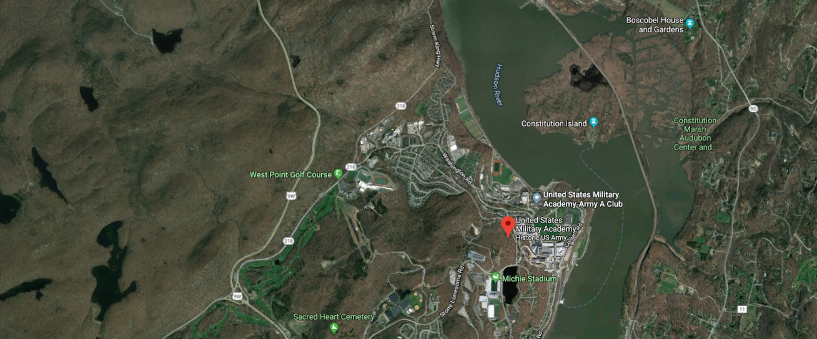
Extending GIFT Wrap to Live Training
Fleet Davis – BMT
Jennifer Riley – Design Interactive
Benjamin Goldberg – CCDC-Soldier Center, STTC
16 May 2019

Slide 2
Agenda
Background
  GIFT Wrap and Course Development
  Generations of GIFT Wrap
4th Generation of GIFT Wrap
  Extending to Live Training Exercises
Limitations and Challenges
  Interoperability & Integration
  Authoring Limitations
Conclusions and Recommendations for Future Research

Slide 3
Background

Slide 4
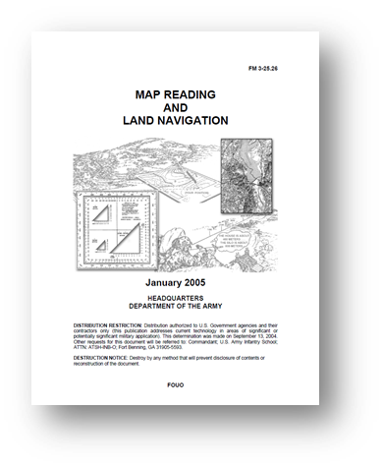
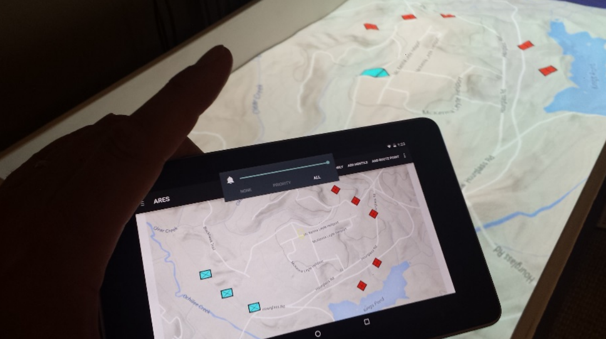
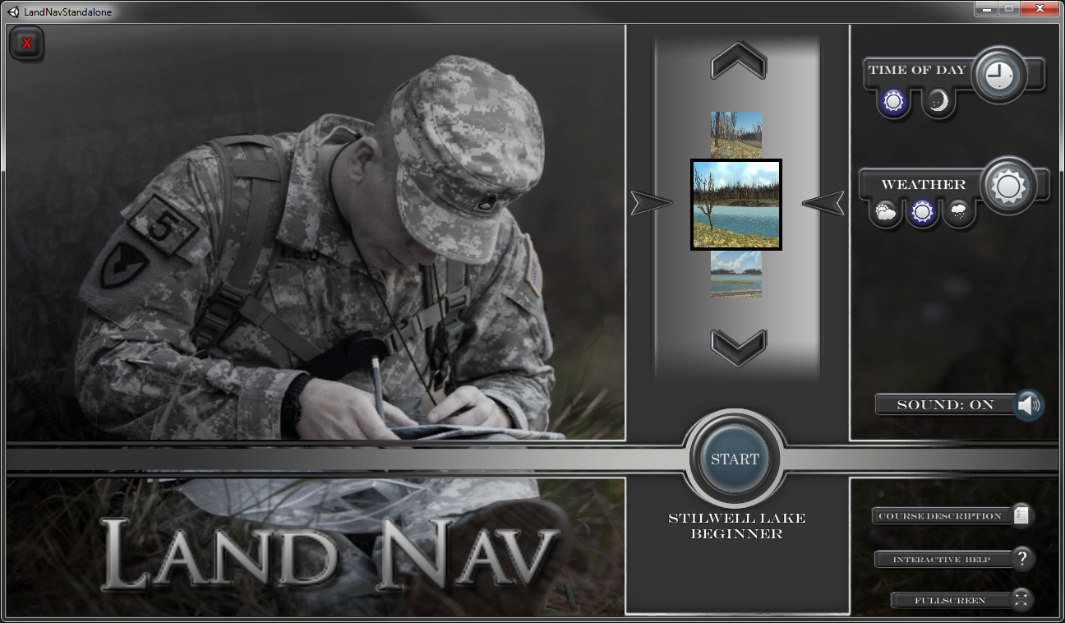
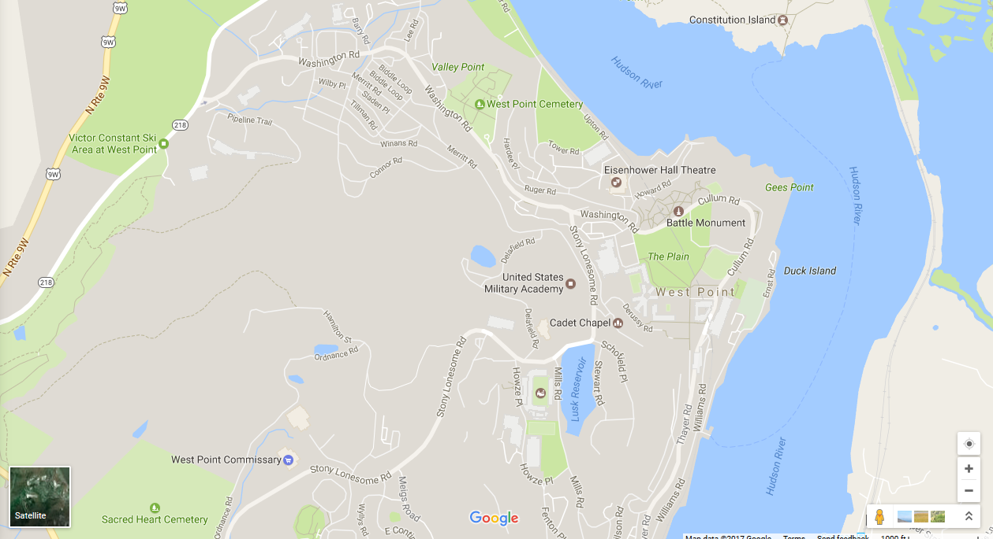
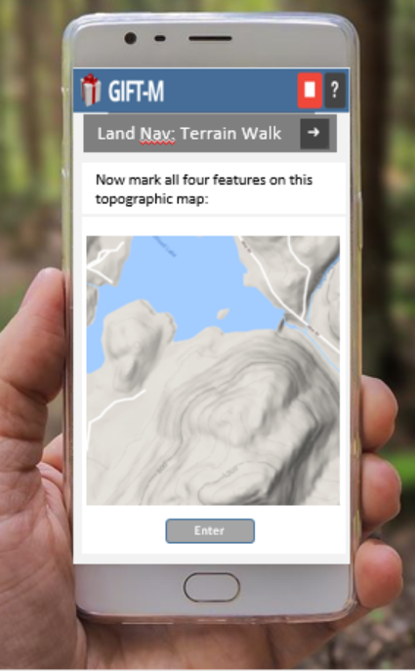
GIFT Wrap
Project Overview
  Multi-year, R&D effort aimed at developing a fully-integrated, user-friendly tool for authoring individual, adaptive training
  Use Case - Army Map Reading and Land Navigation training
  Crawl-Walk-Run (CWR) Model
    Crawl - establish the rules and req’s associated with task performance
    Walk - provide opportunities for skill development through scenario exercises with performance monitoring and real-time coaching
    Run - provide opportunities for trainees to execute tasks based on their ability w/ little instructor intervention
  Sequence of exercises across complimentary platforms with training interactions that build on one another
CRAWL
WALK
RUN

Slide 5
GIFT Wrap within the Course Development Process
RTAs that occur during a course
  Define course concepts, select TA (course objects RTAs applied to)
  Option 1
    Practice skills related to concepts
    GIFT Wrap
      Concept to be assessed, the manner of assessment, the criterion for triggering the assessment, the criterion for assessing performance, and the strategy to be applied given the performance outcomes
  Option 2
    Adaptive course flow object
      Remedial instruction
    GIFT Wrap
      Used as a check on learning
    Acceptable – allowed to move ahead in the course
    Unacceptable – remain within the flow/loop of the adaptive course flow object

Slide 6
Evolution of GIFT Wrap Development
1st Generation - Crawl
  Integration with ARES
  Create COL survey questions
  Select survey response options directly from the TA’s content creation interface (i.e., ARES terrain map)
  Eliminated the GIFT-TA content creation tools disconnect
Potential Response Options
GIFT
ARES

Slide 7
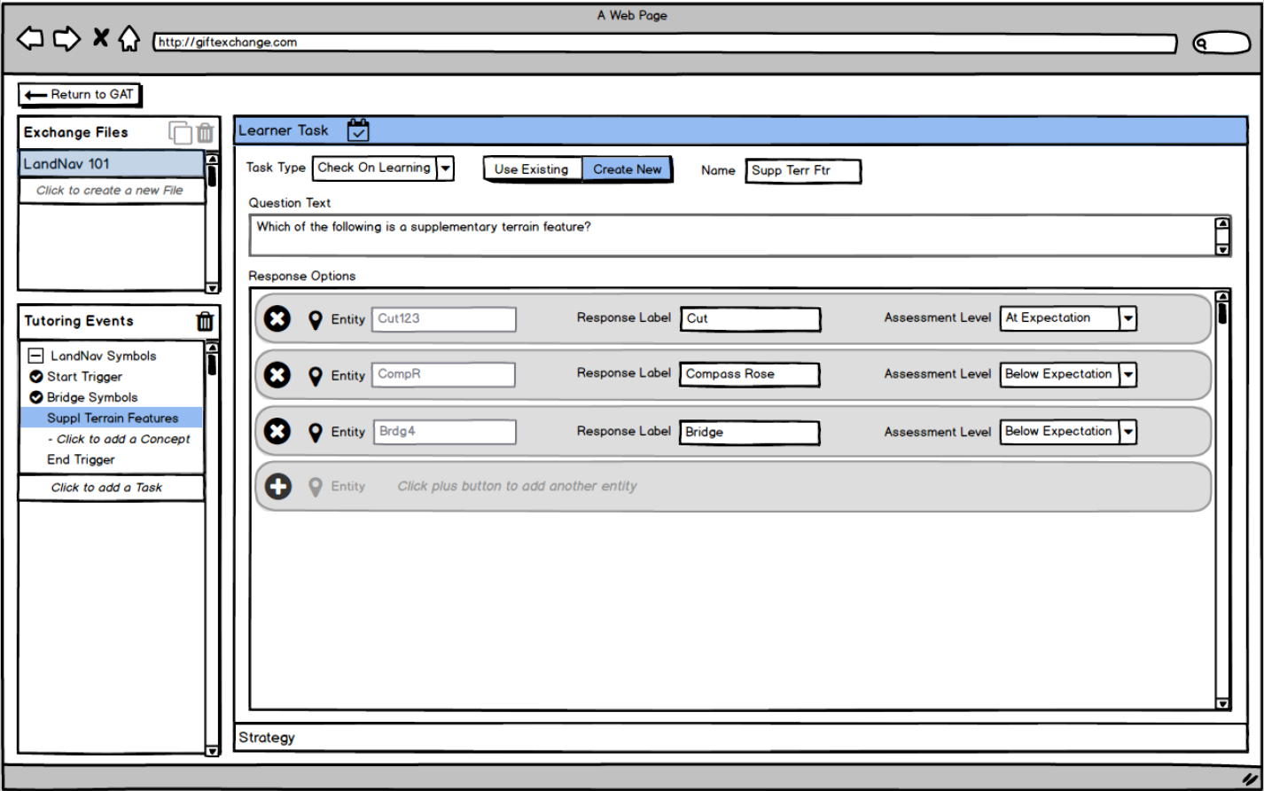
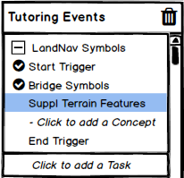
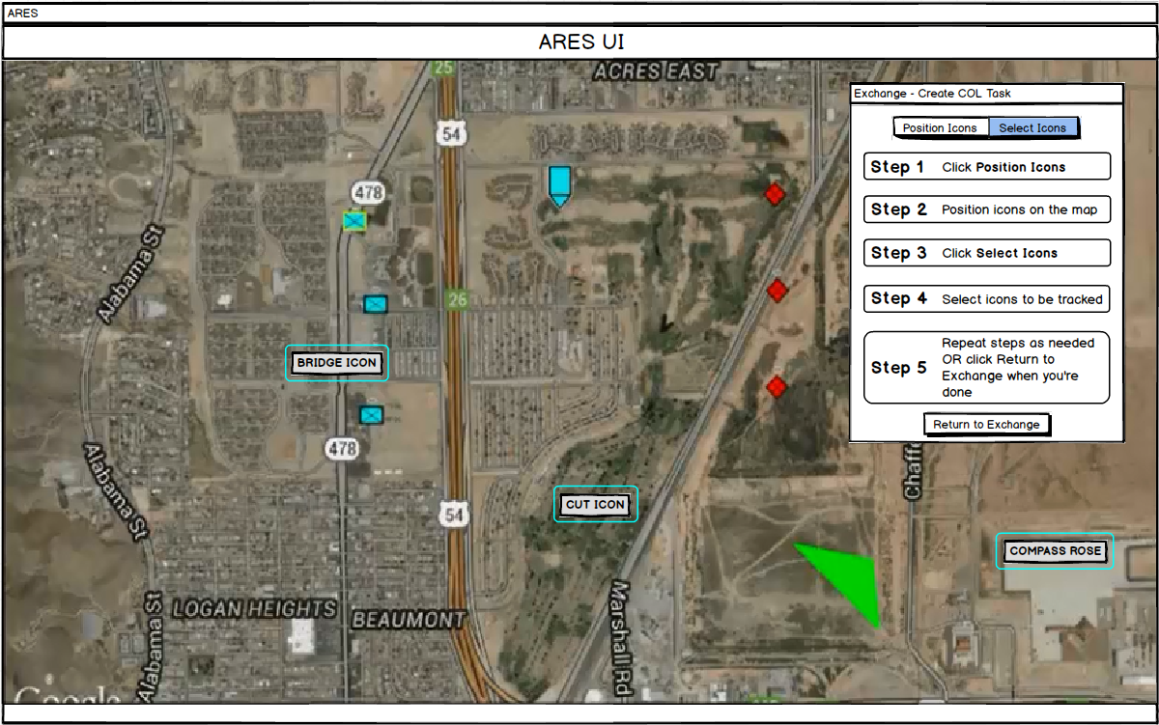
Evolution of GIFT Wrap Development
2nd Generation - Crawl
  Redesigned UI for authoring DKF
    Replace the DAT
  “Blended Authoring Environment” – author RTAs directly within the context of a TA’s content creation tools
  Overlay UI – rapidly switch back to the main GIFT Wrap UI and configure the rest of the DKF
Overlay UI
Simple instructions guide the user through each step of the process

Slide 8
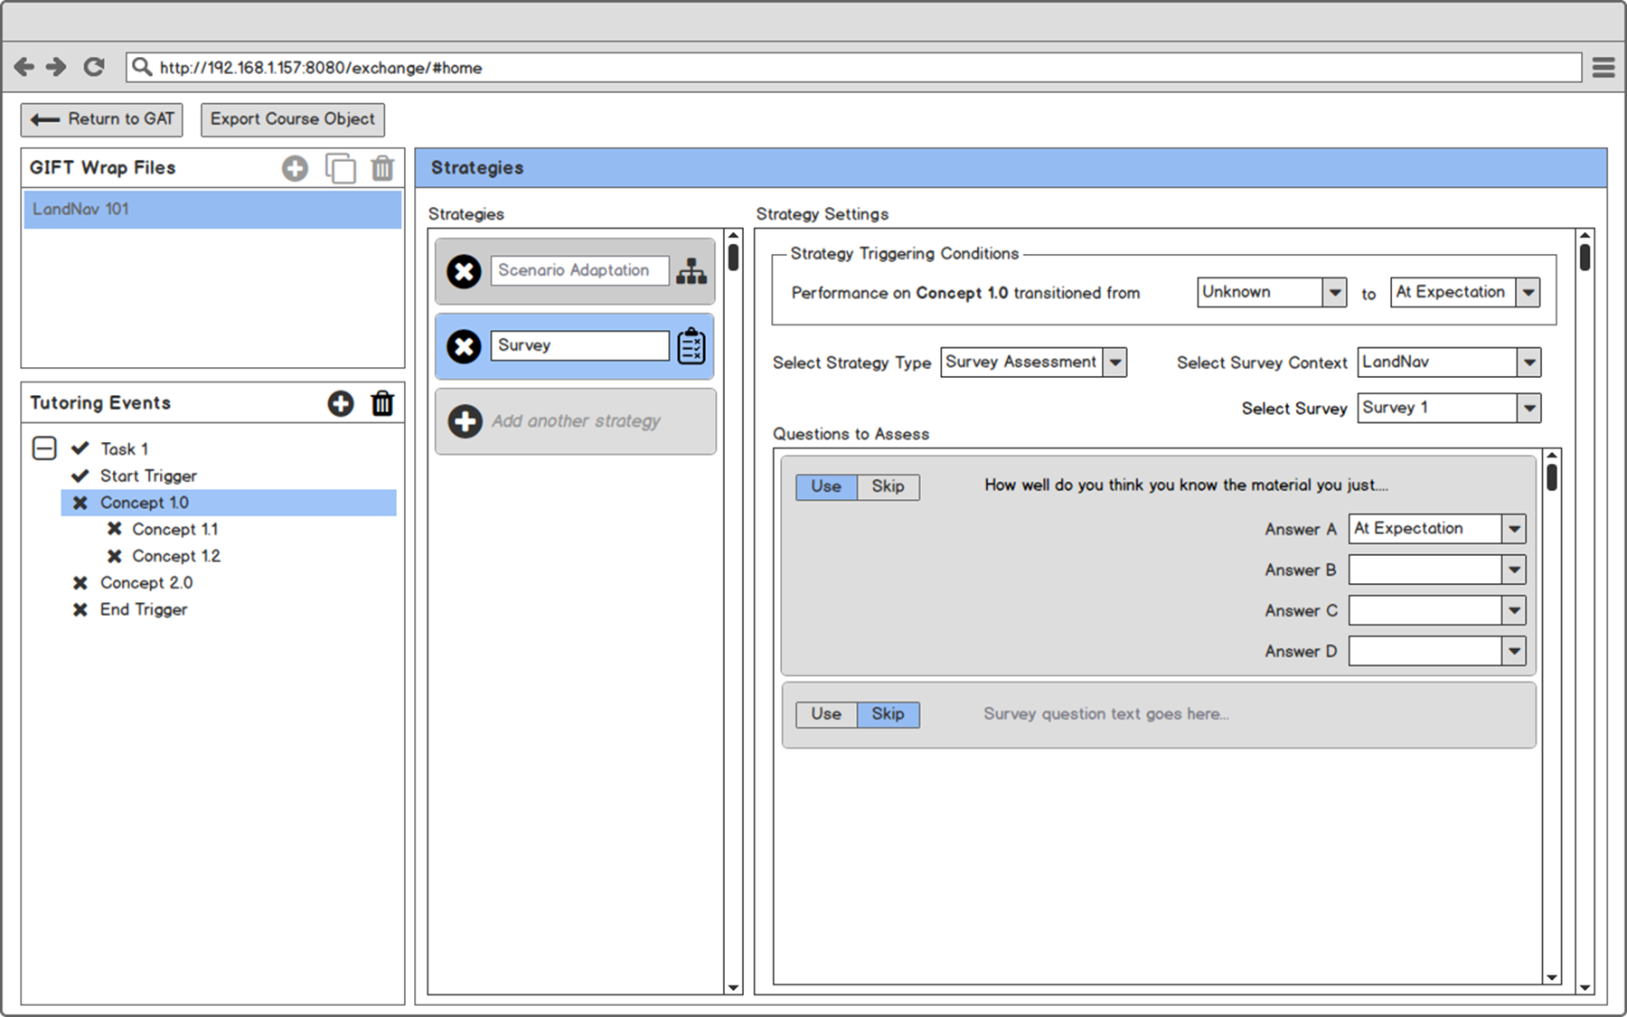

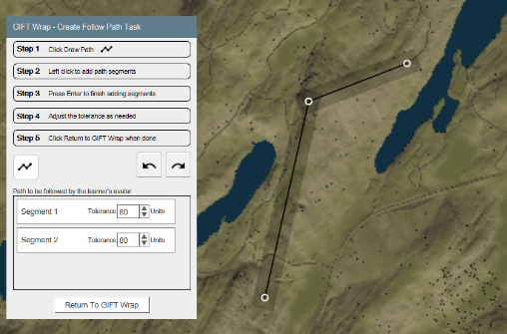
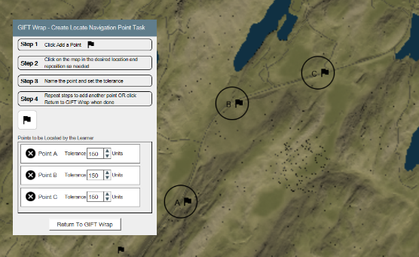
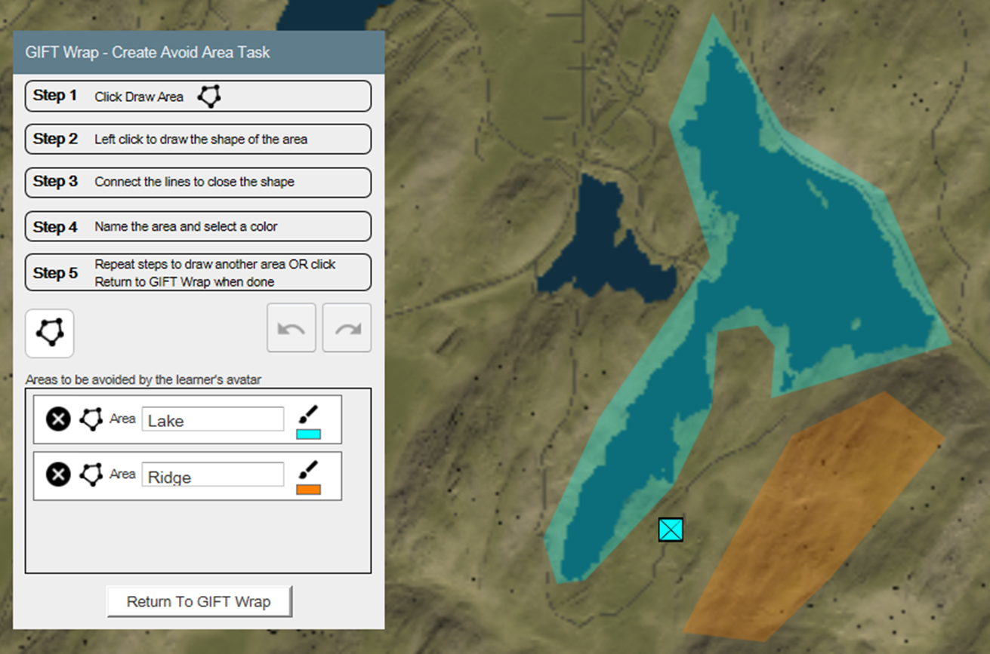
Evolution of GIFT Wrap Development
3rd Generation - Walk
  Incorporated DAT Functionality
    Nested concepts, multiple strategies, time delays for Task triggers
  Extended Blended Authoring Environment
    LandNavHD Unity game
    Integrated with plugin
    New event handlers created for RTAs
  RTAs were created for LandNavHD
    Avoid Area, Follow Path, Locate Navigation Points
  Overlay UI for new RTAs within the LandNavHD environment
    Used a top‐down image of the terrain to simulate the functionality
Multiple strategies
Nested concepts

Slide 9
4th Generation GIFT Wrap

Slide 10
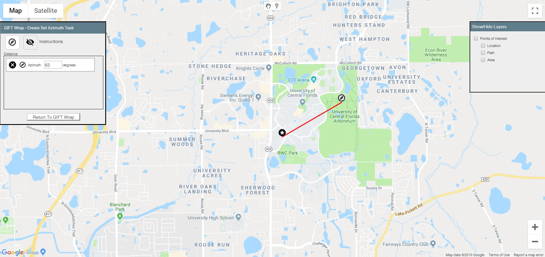
4th Generation GIFT Wrap
4th Generation - Run
  Extended Blended Authoring Environment to live exercises
    Overlay UI integrated with Google Maps via Google Web Toolkit (GWT)
  Mimic “Terrain Walk” exercises at USMA
    Grid Coordinate, Identify Terrain Features, Orient Map, Pace Check, Predict Distance, Set Azimuth
Notes:
Grid Coordinate – assesses the accuracy of the grid coordinate entered by a Learner for a given location.
Identify Terrain Features – assesses the Learner's ability to identify the location of terrain features on a map.
Orient Map – assesses the Learner's ability to orient a map correctly using the direction the Learner's mobile device is pointing as a proxy for the direction they are facing with the map.
Pace Check – assesses the Learner's ability to measure a straight-line distance using the pace count method.
Predict Distance – assesses the Learner's ability to determine the distance between two given points.
Set Azimuth – assesses the Learner's ability to set a given azimuth on their compass. This assessment uses the direction the Learner's mobile device is pointing to determine the Learner's bearing or azimuth.

Slide 11
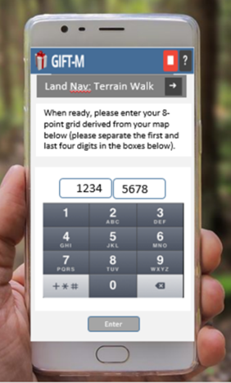
4th Generation GIFT Wrap
Training Delivery
  New RTAs assessments intended to be representative of typical training activities on a navigation course in a RW environment
    Run phase of skill acquisition
  Live instructor replaced with adaptive training provided by the GIFT Tutor User Interface (TUI)
  Training delivered via mobile device, such as smartphone

Slide 12
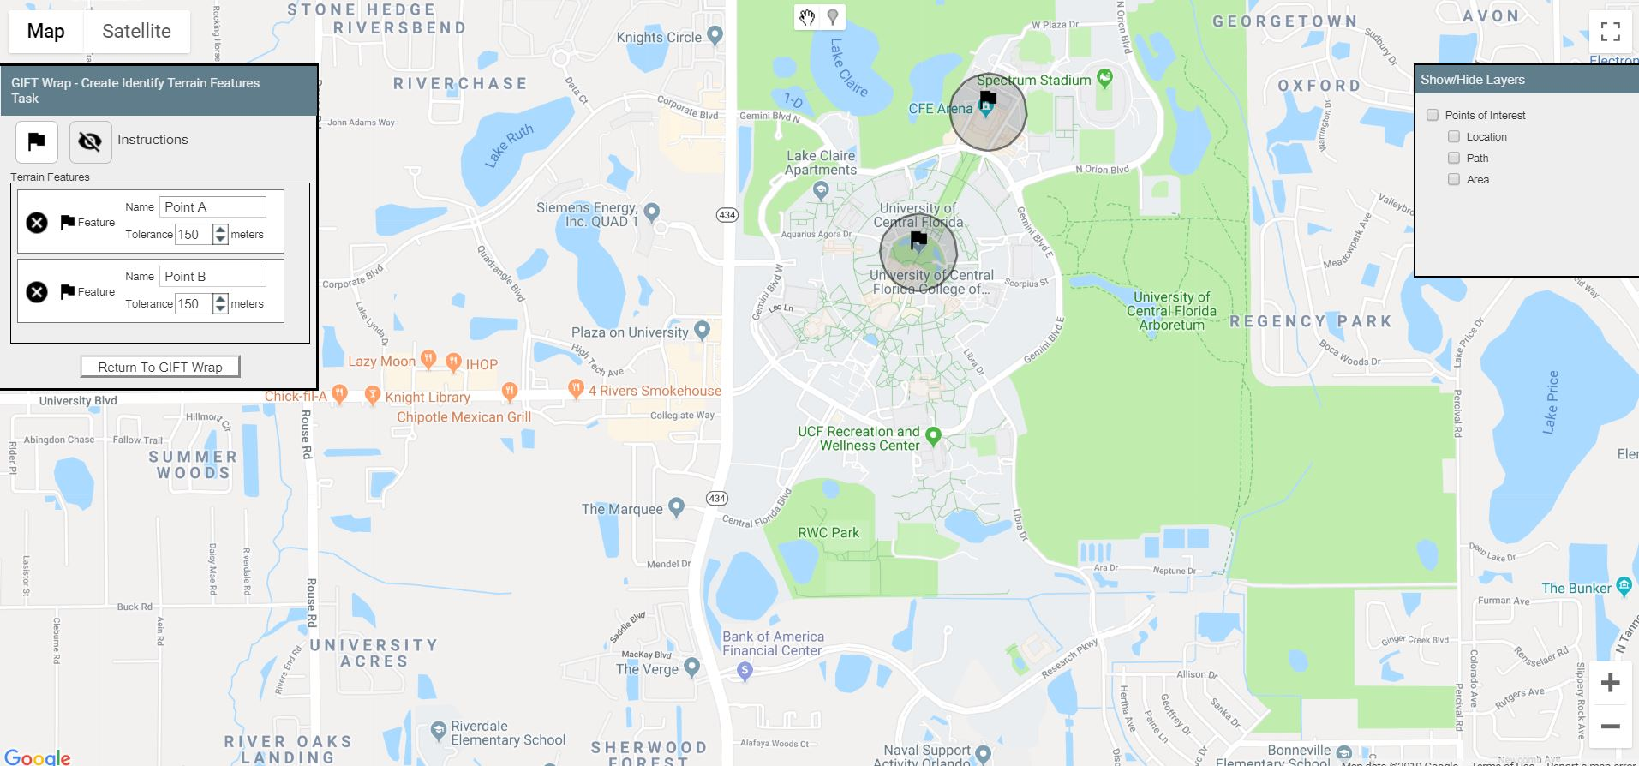
4th Generation GIFT Wrap
Other GIFT Wrap Enhancements
  Show/hide Instructions – reduce the occlusion
  Points of Interest – add common map features or elements (points, path, areas) that may be reused and/or referenced by multiple RTAs
  Layers – show / hide
Identify Terrain Features
Layers Control
PoI used for Terrain Features RTA
Notes:
Show/hide Instructions – reduce the occlusion
Google Maps application as it does not support a “movable” overlay, but requires the overlay be docked in place.
Layers – Considering that users might want to see multiple elements on the same map to visualize the “Terrain Walk” activity, the design was expanded to include controls to show/hide “Layers” which coincide with three common land navigation assessment elements that may be references for multiple condition classes – points, path, areas.
Points of Interest – This feature allows users to add common map features or elements that may be reused and/or referenced by multiple real-time assessments. Multiple points, paths, and/or areas can be set and later selected for use for the set-up of real-time assessments.

Slide 13

Integration Efforts
Google Maps
  Required some workarounds due to incompatibilities.
    Google Maps utilizes a JavaScript API for web development
    GIFT utilizes GWT
    Required a 3rd-party tool to integrate Google Maps with GWT
      GWT-MapsV3-Api creates a bridge between Google Map's JavaScript API and the GWT framework
  GWT solution provided a proof-of-concept, with limitations
    GWT library provided fewer options and an older library which did not allow for use of the most recent Google Maps API features
GIFT Baseline
  Integrated the capabilities previously developed for utilizing LandNavHD and Google Maps for real-time performance assessment
  Modified for extension to other Unity authoring tools
Notes:
application programming interface

Slide 14
Limitations & Challenges

Slide 15
GIFT Wrap Interoperability Limitations and Integration Challenges
Integrating with 3rd-party systems
  Gateway Module and plugins - interoperability and reduced development time
    Still a considerable amount of customization required to establish GIFT Wrap-TA communications for RTAs
  For example, integration with the LandNavHD
    RTAs required positional data from LandNavHD that were not included in the existing GIFT Unity plugin.
    New event handlers had to be added to the plugin that sent messages to GIFT

Slide 16
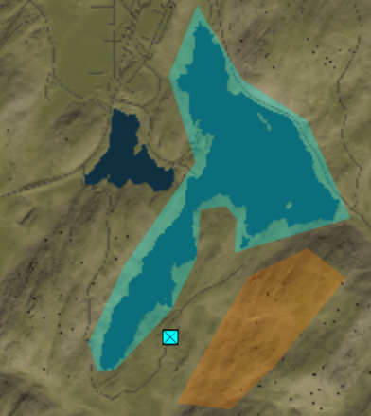
GIFT Wrap Interoperability Limitations and Integration Challenges
Integrating GIFT Wrap authoring capabilities with those of the TA
  Goal was to create a Blended Authoring Environment
    Users perceive the tools as one, seamless authoring experience
  Some TAs simply lack scenario authoring capabilities, workaround required
    For example, the LandNavHD Unity game
  Access to the source code is needed in order to integrate GIFT Wrap functionality
    For example, VBS OME for creating and editing the scenarios
      User could reference elements of the VBS scenario (e.g., waypoints, navigation flags) for RTAs (e.g., Locate Navigation Points)
    Without access to the proprietary VBS source code, it is impossible to implement this functionality and create a seamless authoring experience

Slide 17
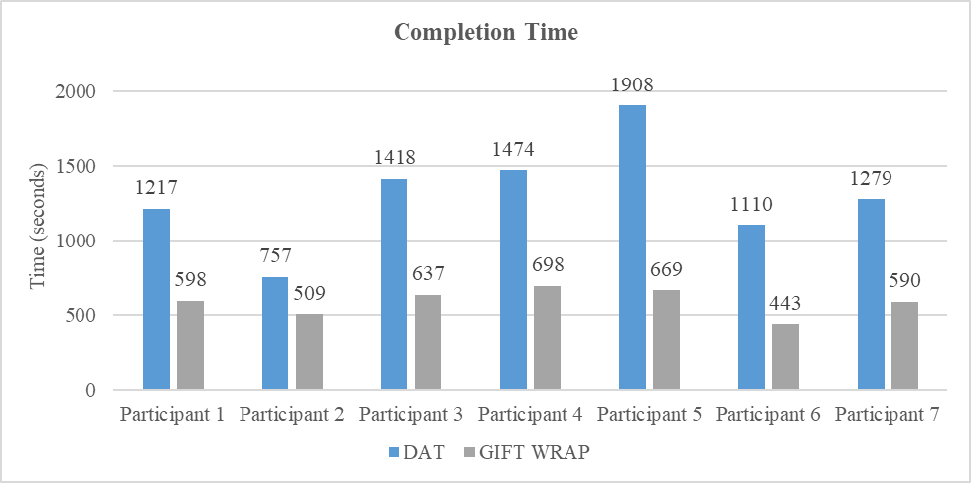
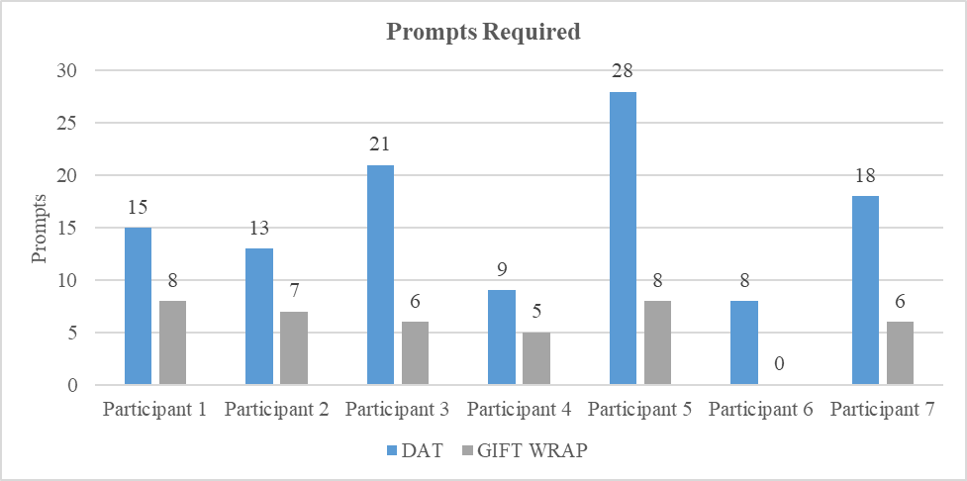
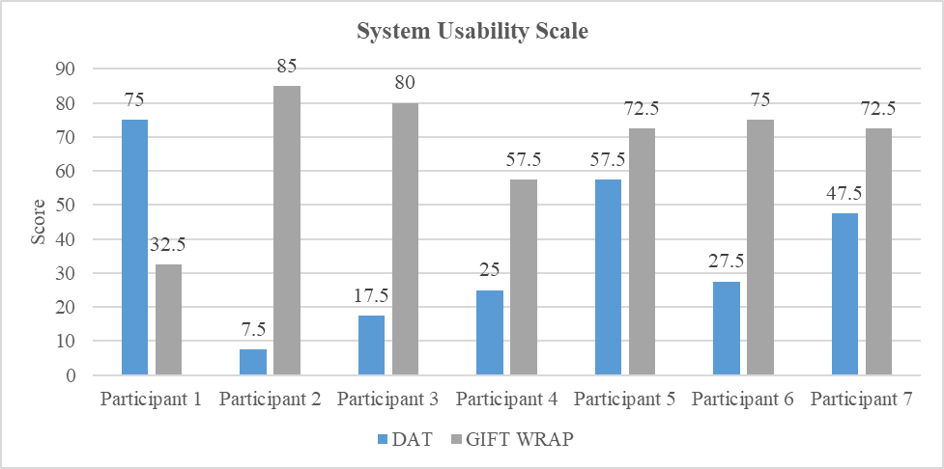
GIFT Wrap Interoperability Limitations and Integration Challenges
Authoring Limitations and Challenges
  Maximizing usability has been a focus throughout the project
    Usability evaluations were conducted as GIFT Wrap gradually incorporated DAT functionality and added new capabilities
  CBTS capabilities continue to advance → use cases for GIFT Wrap broaden
    RTAs are becoming more robust
    Scenarios are growing in complexity
    Potential applications of CBTS are expanding beyond individuals and small teams to multi-echelon, collective training in new domains
  Existing UI features may not accommodate new use cases
  Authoring tools will need to be modified / redesigned to accommodate these changes without compromising the usability of the tool

Slide 18
Conclusions and Recommendations for Future Research

Slide 19
Conclusions
4th Generation GIFT Wrap
  Extended GIFT’s authoring capabilities for live, land navigation training via integration with Google Maps and GIFT mobile capabilities
  GIFT Wrap is now capable of supporting a CWR approach to training for the Map Reading and Land Navigation use case
CRAWL
WALK
RUN

Slide 20
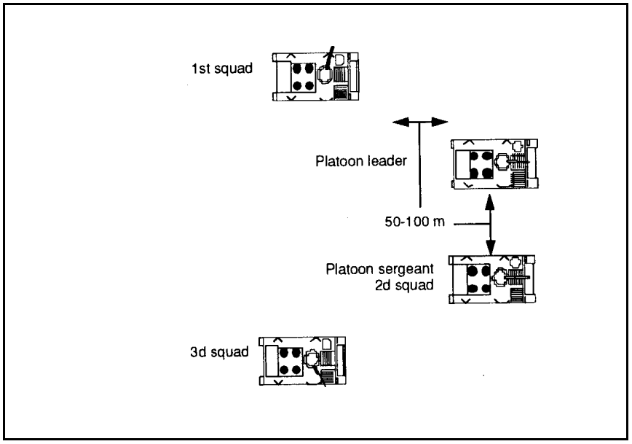
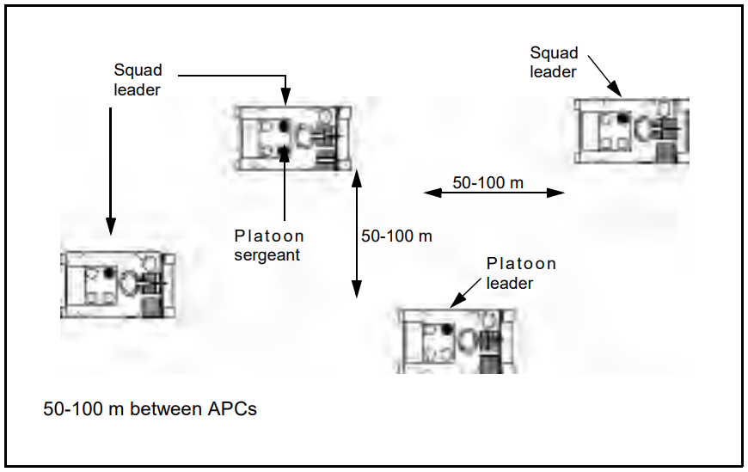
Recommendations for Future Research
Future of GIFT Wrap
  Past - authoring individual, adaptive training
  Existing GIFT Wrap authoring capabilities and Condition Classes are applicable and/or easily modifiable to accommodate new TAs, domains, etc.
  Extend GIFT Wrap to…
    Army elements (e.g., squad, platoon) for collective training
    Applications across Army domains (e.g., armored, mission command).
      For example, RTAs for a company team practicing a wedge formation and/or adjusting to the appropriate formation under different circumstances
“No enemy contact is expected. Should you switch from a Wedge to a Column formation?”
“Good job! The Column formation maximizes C2 and the speed of the
formation.”

Slide 21
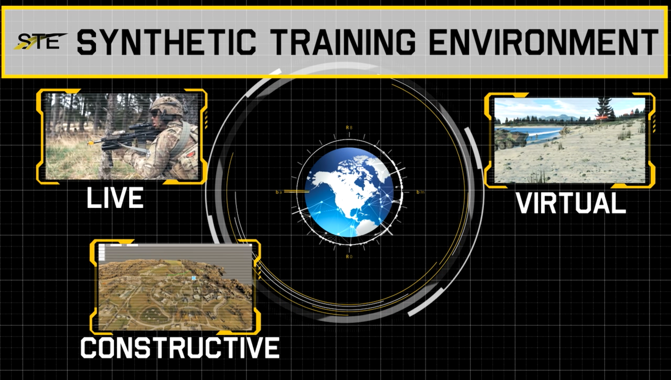
Recommendations for Future Research
Future of GIFT Wrap
  Continuously examine and iteratively improve the GIFT Wrap user experience as use cases continue to be added
    For example, the GIFT Wrap UI could be modified to facilitate authoring and visualizing dependencies among numerous events
      Triggering events, team behaviors and/or performance, the impact of instructional strategies, etc.
  Explore alternative UI designs to accommodate future applications
    For example, operational requirements for the Army’s STE capability
    Working across LVC
    Informing the design of TMT
      Guide users through the entire plan, prepare, execute, and assess process
Notes:
Single, interconnected training capability that provides a Common Synthetic Environment (CSE) that delivers a comprehensive, collective training and mission rehearsal capability.

Slide 22
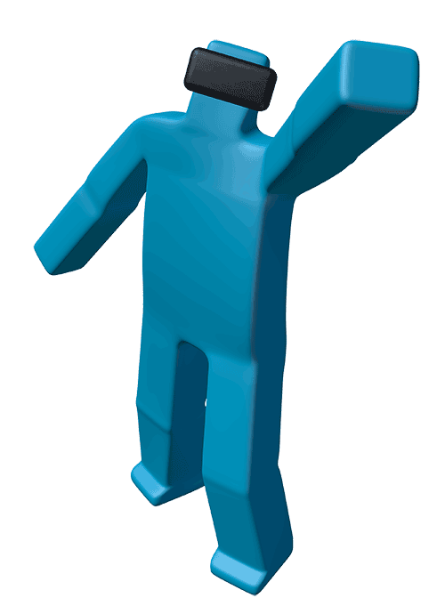

Thank You
Fleet Davis
Senior Human Factors Engineer
BMT
4401 Ford Avenue
Suite 1000
Alexandria, VA 22302
United States
Mobile: +1 407 963 0195 fdavis@dandp.com
Notes:
E

